Slide 1



Big Data: Apache Spark on HDInsight
Speaker name

Slide 2
Introduction
Class hours
8:00 A.M. to 5:00 P.M.
Restrooms
Meals
11:00 A.M. – 15 minutes break
Noon – Lunch
3:00 P.M. – 15 minutes break
Internet connectivity

Slide 3
Agenda – Apache Spark
Day 1
Time | Title
8:00 - 8:30 | Welcome and overview
8:30 - 9:30 | Apache Spark overview
9:30 - 9:45 | Break
9:45 - 11:00 | Working with Resilient Distributed Datasets (RDDs)
11:00 - 11:45 | Working with notebooks on Apache Spark
11:45 - 12:45 | Lunch
12:45 - 2:15 | Spark SQL overview
2:15 - 3:00 | Running interactive Spark SQL queries with Jupyter and Zeppelin notebooks
3:00 - 3:15 | Break
3:15 - 4:00 | Working with Apache Hive and Microsoft Power BI in Apache Spark
4:00 - 4:15 | Day One wrap-up

Slide 4
Agenda – Apache Spark
Day 2
Time | Title
8:00 - 8:15 | Welcome back
8:15 - 9:15 | Spark Streaming overview
9:15 - 10:00 | Spark Streaming with Event Hubs and Scala applications
10:00 - 10:15 | Break
10:15 - 11:00 | Machine learning with Spark MLlib
11:00 - 11:45 | Building applications with Spark MLlib
11:45 - 12:30 | Apache Spark in Azure HDInsight
12:30 - 12:45 | R Server on HDInsight with Apache Spark
12:45 - 1:00 | Day Two and final wrap-up

Slide 5

© 2016 Microsoft Corporation. All rights reserved. Microsoft, Windows, Windows Vista and other product names are or may be registered trademarks and/or trademarks in the U.S. and/or other countries.
The information herein is for informational purposes only and represents the current view of Microsoft Corporation as of the date of this presentation. Because Microsoft must respond to changing market conditions, it should not be interpreted to be a commitment on the part of Microsoft, and Microsoft cannot guarantee the accuracy of any information provided after the date of this presentation. MICROSOFT MAKES NO WARRANTIES, EXPRESS, IMPLIED OR STATUTORY, AS TO THE INFORMATION IN THIS PRESENTATION.

Slide 6
Apache Spark overview
Speaker name

Slide 7

Learning objectives
A unified framework
Apache Spark and Hadoop
Performance and architecture
Use cases

Slide 8
A unified framework

Slide 9
Apache Spark: A unified framework
A unified, open source, parallel data processing framework for big data analytics
Spark SQL
Interactive queries
Spark Streaming
Stream processing
Spark MLlib
Machine learning
GraphX
Graph computation
Spark core engine
Yarn
Mesos
Standalone scheduler
HDFS
Azure Data Lake Store, Blob Storage
Notes:
Objective: Apache Spark unifies batch processing, real-time processing, stream analytics, machine learning, and interactive SQL.
Talking points:
Apache Spark is an open source processing framework that runs large-scale data analytics applications. Built on an in-memory compute engine, Spark is known for high performance querying on big data. It leverages a parallel data processing framework that persists data in-memory and disk if needed. This allows Spark to deliver both 100x faster speed and a common execution model to various tasks like extract, transform, load (ETL), batch, interactive queries on data in Hadoop distributed file system (HDFS).
General capabilities of Spark include:
One execution model for multiple tasks: Apache Spark leverages a common execution model for doing multiple tasks like ETL, batch queries, interactive queries, real-time streaming, machine learning, and graph processing on data stored in Azure Storage.
In-memory processing for interactive scenarios: Apache Spark persists data in-memory and disk if needed to achieve up to 100x faster queries while processing large datasets in Hadoop. This makes Spark for Azure HDInsight ideal to speed up intensive big data applications.
Developer friendly: Spark supports a variety of development languages like Java, Python, and Scala APIs to ease development. You can write sophisticated parallel applications with a collection of over 80 operators, allowing developers to rapidly iterate over data.
Apache Spark comprises four aspects for the purposes of big data analytics:
Spark SQL – interactive queries
Spark Streaming – stream processing
SparkMLlib – machine learning
GraphX – graph computation

Slide 10
Apache Spark benefits
Performance
Developer productivity
Unified engine
Ecosystem
Notes:
Objective: This slide is meant to highlight the benefits of Apache Spark.
Talking points:
Performance
While using in-memory computing, Spark is considerably faster than Hadoop (100x in some tests).
Spark can be used for batch and real-time data processing.
Developer productivity
Spark offers easy-to-use application programming interfaces (APIs) for processing large data sets.
Spark includes 100+ operators for transforming data.
Unified engine
Integrated framework includes higher-level libraries for interactive SQL queries, streaming data processing, machine learning, and graph processing.
Spark offers a single application that can combine all types of processing.
Ecosystem
Spark has built-in support for many data sources such as HDFS, RDBMS, S3, Apache Hive, Cassandra, and MongoDB.
Spark runs on top of the Apache YARN resource manager.

Slide 11

Advantages of a unified platform
In many pipelines, data exchange between engines is the dominant cost.
Input streams of events
Spark Streaming
Machine learning
Spark SQL
NoSQL DB
Notes:
Objective: This slide describes the advantages of a Windows-based OS in performing and processing data and analytics through a unified platform.
Talking points:
Unified platform improves developer productivity by providing a single consistent set of APIs.
All systems in Spark share the same abstraction—Resilient Distributed Datasets (RDDs).
Users can mix and match different kinds of processing in the same application. This is a common requirement for many big data pipelines.
Performance improves because unnecessary movement of data across engines is eliminated.

Slide 12
Apache Spark and Hadoop

Slide 13
Spark integrates well with Hadoop
Alternative resource managers: Mesos or the Spark resource manager
Spark
Primary resource managers: Hadoop 1.0+ or Hadoop YARN
Hadoop
Notes:
Objective: This slide shows how Apache Spark integrates well with Apache Hadoop through various resource managers.
Talking points:
These are “under the hood” resource managers
Spark can use Hadoop 1.0 or Hadoop YARN as resource managers.
Spark can also work with other resource managers:
Apache Mesos
Spark resource manager
Spark does not have its own storage layer but it can read and write directly to HDFS.
Spark integrates with Hadoop ecosystem projects such as Apache Hive and Apache HBase.

Slide 14
Performance and architecture

Slide 15
Faster data, faster results
140
Spark is the 2014 Sort Benchmark winner.
3x faster than 2013 winner (Hadoop).
120
Hadoop
100
Spark is fast not just for in-memory, but for on-disk computation too.
80
Running time(s)
60
40
20
Spark
0
0.9
Logistic regression
Logistic regression on a 100-node cluster with 100 GB of data.
tinyurl.com/spark-sort
Notes:
Objective: This slide highlights the importance of speed when data processing is needed.
Talking points:
In iterative applications, the same data is accessed repeatedly, often in a sequence.
Most machine learning algorithms and streaming applications (that maintain an aggregate state) are iterative in nature.

Slide 16

What makes Spark fast?
Data sharing between steps of a job
Reads from HDFS
Writes to HDFS
Reads from HDFS
Writes to HDFS
In traditional MapReduce
Step 1
Step 2
Reads and writes
from HDFS
In Spark
Step 1
Notes:
Objective: This slide describes the architecture of how Apache Spark is different, allowing it to offer better performance for data sharing.
Talking points:
Spark provides primitives for in-memory cluster computing. A Spark job can load and cache data into memory and query it repeatedly, much more quickly than disk-based systems.
Spark integrates into the Scala programming language to let you manipulate distributed data sets like local collections. No need to structure everything as map and reduce operations.
Data sharing between operations is faster, since data is in-memory.
Hadoop shares data through HDFS, an expensive option. It also maintains three replicas.
Spark stores data in-memory without any replication.

Slide 17
Spark cluster architecture
Driver program SparkContext
Cluster manager
The driver runs the user’s main function and executes the various parallel operations on the worker nodes.
The driver collects the results of the operations.
Worker nodes read and write data from/to Hadoop distributed file system (HDFS).
Worker nodes also cache transformed data in-memory as RDDs.
Worker node
Worker node
Worker node
Worker node
Cache
Cache
Cache
Task
Task
Task
Read
Read
Read
HDFS
Notes:
Objective: This describes the Spark cluster architecture and how it works.
Talking points:
Here is the Spark cluster architecture and how it works:
In the head node, we have the Spark master that manages the number of applications, the apps are mapped to the Spark driver. Every app is managed by Spark master in various way. Spark can be deployed on top of Mesos, Yarn, or the Spark cluster manager, which allocates worker node resources to an application. The resources in the cluster are managed by Spark master in the HDInsight. That means the Spark master has knowledge of what resources like memory that are occupied or available on the worker node.

Slide 18
The Spark cluster architecture driver
The driver performs the following:
Driver program SparkContext
Cluster manager
Connects to a cluster manager to allocate resources across applications
Acquires executors on cluster nodes while processes run compute tasks and cache data
Sends app code to the executors
Sends tasks for the executors to run
Worker node
Worker node
Worker node
Worker node
Cache
Cache
Cache
Task
Task
Task
Executor
Executor
Executor
Notes:
Objective: This slide describes the Spark cluster driver architecture and how it works.
Talking points:
Here is the Apache Spark architecture and how it works:
Once the app is created in the Spark master, the resources are allocated to the apps by Spark master, creating an execution called the Spark driver. Spark driver basically creates the SparkContext. When it creates the SparkContext, it start creating the RDDs. The metadata of RDDs are stored on the Spark driver.
Spark driver connects to the Spark master and is responsible for converting an application to a directed graph (DAG) of individual tasks that get executed within an executor process on the worker nodes. Each application gets its own executor processes, which stay up for the duration of the whole application and run tasks in multiple threads.

Slide 19
Demo
Spark architecture
Notes:
Demo: Spark Architecture (Channel 9)
Source:
https://channel9.msdn.com/Series/Azure-Data-Lake/Whats-up-with-Spark15-Spark-Architecture

Slide 20
Cluster
Worker node 1
Browser
Gateway
Spark submit
Zeppelin
Jupyter
Worker 1
Job
Task
Task
Worker node 2
Head node
Worker 2
Job
Task
Spark master
Task
App 0
App 1
App 2
Worker node 3
Worker 3
Job
Task
Task
Spark driver
RDD
Worker node 4
Spark context
Worker 4
Job
Task
RDD
Task
This is just an example, worker node capacity is much greater than 4 nodes
Notes:
Objective: This slide offers a Spark Architecture demo.
Instructions:
Now let’s see from the information flow perspective:
The customer opens up the browser as an entry point with the cluster name and Domain Name System (DNS). The user is then authenticated and comes to this gateway. From the gateway, we have the interaction through notebooks such as Zeppelin and Jupyter. If you want to use the spark-submit script, you need to use Microsoft Remote Desktop Protocol (RDP) for the cluster pointing to the head node.
When the customer starts the notebook session, Zeppelin will create the SparkContext automatically, register the application in the Spark master, and then create the Spark driver.
In the case of Jupyter, it is just a blank canvas, so you need to manually create the SparkContext and the Spark master URL that you want to use. From there you create the Spark master.
Once the notebook is set up, you can use Scala, Python, or SQL code to interact with your Spark components.

Slide 21
Use cases

Slide 22
Apache Spark use cases
High performance batch computation
Interactive analytics
Machine learning
Real-time stream processing
Developer productivity
Notes:
Objective: This slide provides instances of when Spark is useful in analytics and data computation.
Talking points:
Data integration and ETL
Description: cleanses and combines data from diverse sources
Users: Palantir (analytics platform)
Interactive analytics
Description: offers insights from massive data sets in ad-hoc investigations or regularly planned dashboards
Users: Goldman Sachs (analytics platform) and Huawei (query platform in the telecom sector)
High performance batch computation
Description: runs complex algorithms against large-scale data
Users: Novartis (genomic research) and MyFitnessPal (food data processor)
Machine learning
Description: predicts outcomes to make decisions based on input data
Users: Alibaba (marketplace analysis) and Spotify (music recommendations)
Real-time stream processing
Description: captures and processes data continuously with low-latency and high reliability
Users: Netflix (recommendation engine) and British Gas (energy and home services provider)

Slide 23
© 2016 Microsoft Corporation. All rights reserved. Microsoft, Windows, Windows Vista and other product names are or may be registered trademarks and/or trademarks in the U.S. and/or other countries.
The information herein is for informational purposes only and represents the current view of Microsoft Corporation as of the date of this presentation. Because Microsoft must respond to changing market conditions, it should not be interpreted to be a commitment on the part of Microsoft, and Microsoft cannot guarantee the accuracy of any information provided after the date of this presentation. MICROSOFT MAKES NO WARRANTIES, EXPRESS, IMPLIED OR STATUTORY, AS TO THE INFORMATION IN THIS PRESENTATION.

Slide 24
Working with RDDs
Speaker name

Slide 25
Learning objectives
RDDs
RDD operations
Accumulators

Slide 26
RDDs

Slide 27
Core abstraction: RDDs
Primary abstraction in Spark
Two types:
Parallelized collection
Hadoop data set
RDD can be persisted in-memory across operations
Cached or persistent RDDs are fault tolerant without replication
Notes:
Objective: This slide introduces the types and uses of RDDs.
Talking points:
The primary abstraction is Spark, a fault-tolerant collection of elements stored in-memory or on-disk that can be operated on in parallel.
Two types:
Parallelized collection: apply a parallel transformation to an existing Scala collection; users must specify the number of partitions.
Hadoop data set: run functions on each record of a file in HDFS or any other storage system supported by Hadoop.
Can be persisted in-memory across operations. When an RDD is persisted, each node stores any partitions of it that it computes in-memory and then reuses them in other actions on the data set.
Can mark an RDD as persistent just by calling the persist() or cache() method.
Can specify the storage level: on-disk or in-memory as a serialized Java object.
Cached or persistent RDDs are fault tolerant without replication.
Each RDD maintains its lineage (example: the sequence of transformations that resulted in the RDD).
If an RDD is lost because a node crashed, it can be reconstructed by replaying the sequence of operations.

Slide 28
RDD operations

Slide 29
RDDs: Transformations and actions
RDD
RDD
Transformations
RDD
Actions
Value
RDD
RDD
Notes:
Objective: This slide explains the two types of operations that RDDs support: transformation and actions.
Talking points:
Transformations create a new data set from an existing data set.
Transformations do not compute their results right away. They are only computed when an action requires a result to be returned to the driver program. Does not apply to persistent RDDs.
Examples include: map, filter, sample, union, and more.
Actions return a value to the driver program after running a computation on the data set.
Examples include: reduce, collect, count, first, foreach, and more.

Slide 30
Transformations and actions: Sample code
Sample code to search through error messages in a log file (stored in HDFS)
val file = spark.textFile("hdfs://...")
val errors = file.filter(line => line.contains("ERROR"))
// Cache errors
errors.cache()
// Count all the errors
errors.count()
// Count errors mentioning MySQL
errors.filter(line => line.contains(“Web")).count()
// Fetch the MySQL errors as an array of strings
errors.filter(line => line.contains(“Error")).collect()
Transformation: hdfs(), filter()
Action: count(), collect()
Cache() is a method
Notes:
Objective: This slide shows an example of how transformations and actions are enabled to search through error messages.
Talking points:
Cache errors – Implementing this action will collect all the errors present
Count all errors – Implementing this action counts all the errors in the data
Count errors mentioning MySQL – When implementing this code, MySQL errors are counted
Fetch the MySQL errors as an array of strings – When implementing this code, MySQL errors are extracted as an array of strings

Slide 31
RDD transformations
Sample code of all RDD transformations
// Returns a new distributed data set formed by passing each
element of the source through a function func.
map(func)
// Returns a new data set formed by selecting those elements
of the source on which func returns true.
filter(func)
// Returns a new data set that contains the union of the
elements in the source data set and in the argument.
union(otherDataset)
// Returns a new data set that contains the distinct elements of
the source data set.
distinct(([numTasks]))
Notes:
Objective: This slide shows a list of RDD-supported transformations.
Talking points:
map(func) – Returns a new distributed data set formed by passing each element of the source through a function func.
filter(func) – Returns a new data set formed by selecting those elements of the source on which func returns true.
flatmap(func) – Similar to map, but allows each input item to be mapped to zero or more output items (func should return a Seq rather than a single item).
sample(withReplacement, fraction, seed) – Samples a fraction of the data, with or without replacement, using a given random number generator seed.
union(otherDataset) – Returns a new data set that contains the union of the elements in the source data set and in the argument.
distinct(([numTasks])) – Returns a new data set that contains the distinct elements of the source data set.
groupBykey([numTasks]) – When called on a data set of (K, V) pairs, returns a data set of (K, Seq[V]) pairs.
reduceByKey(func, [numTasks]) – When called on a data set of (K, V) pairs, returns a data set of (K, V) pairs where the values for each key are aggregated using the given reduce function.
sortByKey([ascending], [numTasks]) – When called on a data set of (K, V) pairs where K implements are ordered, returns a data set of (K, V) pairs sorted by keys in ascending or descending order, as specified in the Boolean ascending argument.
join(otherDataset,[numTasks]) – When called on data sets of type (K, V) and (K, W), returns a data set of (K, (V, W)) pairs with all pairs of elements for each key.
cogroup(otherDataset, [numTasks]) – When called on data sets of type (K, V) and (K, W), returns a data set of (K, Seq[V], Seq[W]) tuples, also called groupWith.
cartesian(otherDataset) – When called on data sets of types T and U, returns a data set of (T, U) pairs (all pairs of elements).

Slide 32
RDD actions
Sample code of all RDD actions
// Writes the elements of the data set as a text file (or a set
of text files) in a given directory in either the local
filesystem, HDFS, or other Hadoop-supported file systems.
Spark will call ToString on each element to convert it to a
line of text in the file.
saveAsTextFile(path)
// Returns a “Map” of (K, Int) pairs with the count of each key.
Only available on RDDs of type (K, V).
countByKey()
// Returns all the elements of the data set as an array at the
driver program. Usually useful after a filter or other operation
returns a sufficiently small subset of the data.
collect()
Notes:
Objective: This slide shows a list of RDD-supported actions.
Talking points:
saveAsTextFile(path) – Writes the elements of the data set as a text file (or a set of text files) in a given directory in either the local filesystem, HDFS, or other Hadoop-supported file systems. Spark will call ToString on each element to convert it to a line of text in the file.
saveAsSequenceFile(path) – Writes the elements of the data set as a Hadoop SequenceFile in a given path in the local filesystem, HDFS, or any other Hadoop-supported file system. Only available on RDDs of key-value pairs that either implement the Writable interface of Hadoop, or are implicitly convertible to Writable (Spark includes conversions for basic types like Int and Double, String).
countByKey() – Returns a “Map” of (K, Int) pairs with the count of each key. Only available on RDDs of type (K, V).
foreach(func) – Runs a function func on each element of the data set. Usually done for side effects, such as updating an accumulator.
reduce(func) – Aggregates elements of the data set using a function func (which takes two arguments and returns one), and should be commutative and associative in order to be computed correctly in parallel.
collect() – Returns all the elements of the data set as an array at the driver program. Usually useful after a filter or other operation returns a sufficiently small subset of the data.
first() – Returns the first element of the data set—similar to take(n).
count() – Returns the number of elements in the data set.
take(n) – Returns an array with the first n elements of the data set. Currently not executed in parallel, instead the driver program computes all the elements.
takeSample (withReplacement, fraction, seed) – Returns an array with a random sample of num elements of the data set, with or without replacement, using the given random number generator seed.

Slide 33
RDD persistence options
Sample code of all RDD persistence options
// Store RDD as deserialized Java objects in the JVM. If the
RDD does not fit in-memory, some partitions will not be cached
and will be recomputed on the fly each time they are needed.
This is the default level.
MEMORY_ONLY
// Store RDD as deserialized Java objects in the JVM. If the
RDD does not fit in-memory, store the partitions that do not
fit on-disk, and read them from there when they are needed.
MEMORY_AND_DISK
// Store RDD as serialized Java objects (one byte array per
partition). This is generally more space-efficient than
deserialized objects, especially when using a fast serializer,
but it is more CPU-intensive to read.
MEMORY_ONLY_SER
Notes:
Objective: This slide shows a list of RDD-supported persistence options.
Talking points:
MEMORY_ONLY – Store RDD as deserialized Java objects in the JVM. If the RDD does not fit in-memory, some partitions will not be cached and will be recomputed on the fly each time they are needed. This is the default level.
MEMORY_AND_DISK – Store RDD as deserialized Java objects in the JVM. If the RDD does not fit in-memory, store the partitions that do not fit on-disk, and read them from there when they are needed.
MEMORY_ONLY_SER – Store RDD as serialized Java objects (one byte array per partition). This is generally more space-efficient than deserialized objects, especially when using a fast serializer, but it is more CPU-intensive to read.
MEMORY_AND_DISK_SER – Similar to MEMORY_ONLY_SER, but spills partitions that do not fit in-memory to disk, instead of recomputing them on the fly each time they are needed.
DISK_ONLY – Stores the RDD partitions only on-disk.
MEMORY_ONLY_2, MEMORY_AND_DISK_2, and more – Same as the levels above, but replicates each partition on two cluster nodes.

Slide 34
Accumulators

Slide 35
Core concept: Accumulators
Gather variables and tasks to counter or sum
Apply an associative operation to understand the driver
Transform numeric value types into new types for better value
Notes:
Objective: This slide gives an explanation of accumulators.
Talking points:
Accumulators are variables that can only be added to through an associative operation.
They are used to implement counters and sums efficiently in parallel.
Spark natively supports accumulators of numeric value types and standard mutable collections; programmers can extend for new types.
Only the driver program can read the value of an accumulator; the tasks cannot.

Slide 36
Hands-on lab
Working with RDDs
Notes:
Hands-on Lab: Microsoft Azure – Analyze logs in HDInsight Spark using a custom library: Save Data as a RDD
Source: https://azure.microsoft.com/en-us/documentation/articles/hdinsight-apache-spark-custom-library-website-log-analysis/

Slide 37
© 2016 Microsoft Corporation. All rights reserved. Microsoft, Windows, Windows Vista and other product names are or may be registered trademarks and/or trademarks in the U.S. and/or other countries.
The information herein is for informational purposes only and represents the current view of Microsoft Corporation as of the date of this presentation. Because Microsoft must respond to changing market conditions, it should not be interpreted to be a commitment on the part of Microsoft, and Microsoft cannot guarantee the accuracy of any information provided after the date of this presentation. MICROSOFT MAKES NO WARRANTIES, EXPRESS, IMPLIED OR STATUTORY, AS TO THE INFORMATION IN THIS PRESENTATION.

Slide 38
Working with notebooks on Apache Spark
Speaker name

Slide 39
Learning objectives
Notebooks overview
Zeppelin
Jupyter

Slide 40
Notebooks overview

Slide 41



Developing Spark apps with notebooks
Jupyter and Zeppelin are two notebooks that work with Apache Spark
Notes:
Objective: This slide defines the notebooks that interact when developing in Apache Spark.
Talking points:
Notebooks are:
Web-based, interactive servers for REPL, also known as Read-Evaluate-Print-Loop style programming.
Well-suited for prototyping, rapid development, exploration, discovery, and iterative development.
Designed to consist of code, data, visualization, comments, and notes.
Designed to enable collaboration among team members.

Slide 42
Jupyter

Slide 43
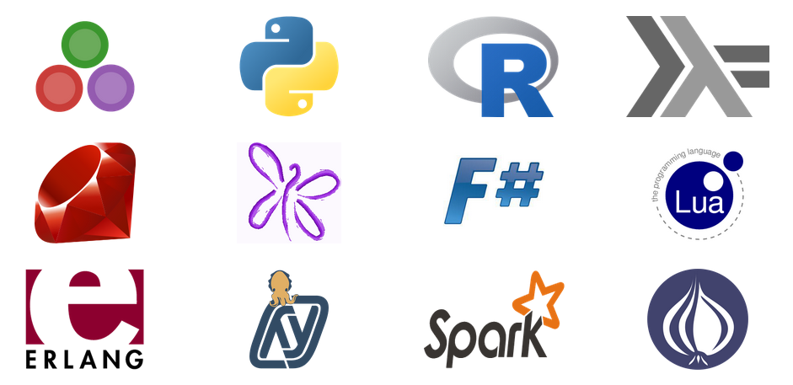
Jupyter
Language agnostic
Supports a rich Read-Evaluate-Print-Loop (REPL) protocol Includes:
Jupyter notebook document format (.ipynb)
Jupyter interactive web-based notebook
Jupyter Qt console
Jupyter Terminal console
Notebook viewer (nbviewer)
Supported languages (kernels)
See full list here
Notes:
Objective: This slide describes the process and architecture of the Zeppelin notebook in Apache Spark.
Talking points:
Its name is inspired by scientific and statistical languages (Julia, Python, and R).
Based on (and an evolution of) IPython. (Soon IPython will not ship separately.)
Is language agnostic. Languages are supported through kernels, a program that runs and introspects the users code.
Supports a rich REPL protocol.
Includes:
Jupyter notebook document format (.ipynb)
Jupyter Interactive web-based notebook
Jupyter Qt console
Jupyter Terminal console
Notebook viewer (nbviewer)

Slide 44
Zeppelin

Slide 45
Zeppelin architecture
Apache Spark is supported in Zeppelin with the Spark interpreter group, which consists of four interpreters.
Browser client
HTTP Rest Websocket
Zeppelin server
Class loader
Class loader
Name | Class | Description
%spark | SparkInterpreter | Creates SparkContext and provides scala environment
%pyspark | PySparkInterpreter | Provides python environment
%sql | SparkSQLInterpreter | Provides SQL environment
%dep | DepInterpreter | Dependency loader
Interpreter group
Interpreter group
Interpreter
Dep
…
Spark
Spark SQL
…
Maven
Spark
Zeppelin is not installed as part of default cluster. Additional steps required.
Notes:
Objective: This slide describes the process and architecture of Zeppelin notebooks in Apache Spark.
Talking points:
Zeppelin is an Apache project currently in incubation.
It provides built-in Apache Spark integration (no need to build a separate module, plugin, or library for it). Spark integration is a feature of Zeppelin, and provides:
Automatic SparkContext and SQLContext injection
Runtime jar dependency loading from local filesystem or maven repository
Job cancellation capabilities while displaying progress
It is based on an interpreter concept that enables any language/data-processing-backend to be plugged into Zeppelin. Current languages included in the Zeppelin interpreter are:
Scala (with Apache Spark)
Spark SQL
Markdown
Shell
Share the notebook URL among collaborators; Zeppelin can then broadcast any changes in real time
Zeppelin provides a URL to display only the results. It does not include a menu or buttons, which means you can easily embed it as an iframe inside of your website

Slide 46
Demo
Jupyter notebook
Notes:
Sources:
What’s Up with Spark – Jupyter and Zeppelin Notebooks (Channel 9)
https://channel9.msdn.com/Series/Azure-Data-Lake/Whats-up-with-Spark35-Jupyter-and-Zepplein-Notebooks
Microsoft Azure – Getting Started: Create Apache Spark cluster on Azure HDInsight (Linux) and run interactive queries using Spark SQL – Run Spark SQL queries using a Jupyter notebook
https://azure.microsoft.com/en-us/documentation/articles/hdinsight-apache-spark-jupyter-spark-sql/

Slide 47
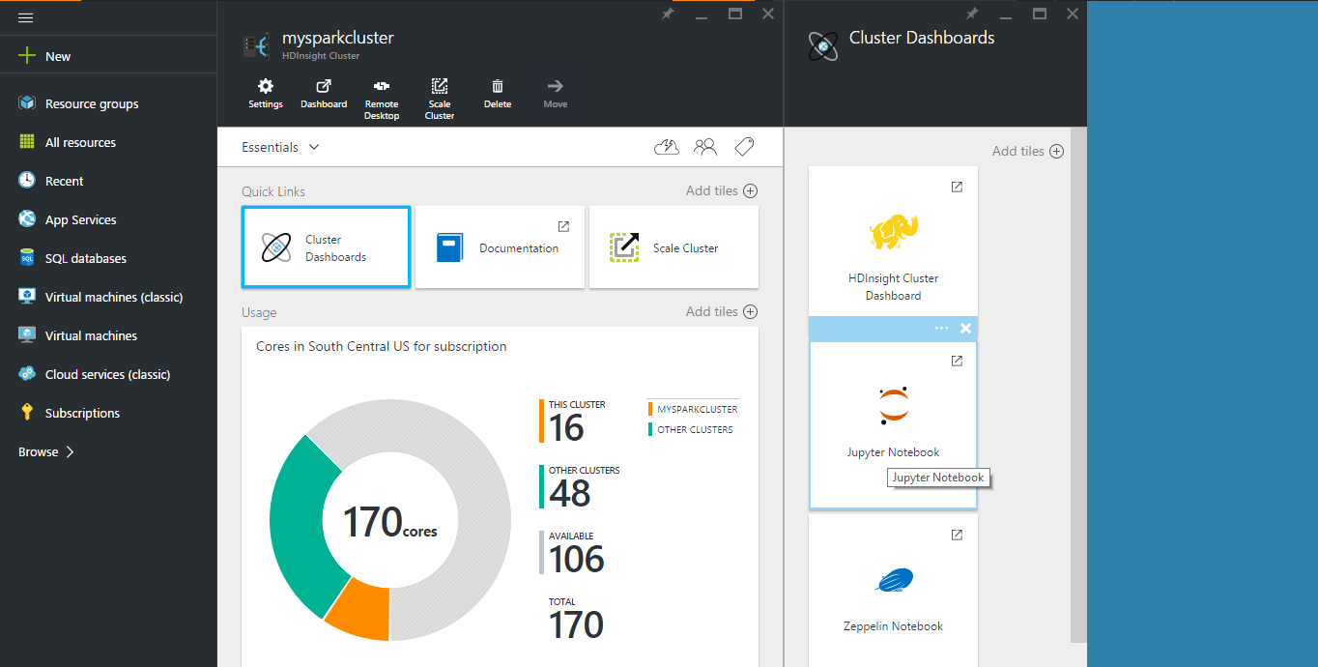
Notes:
Objective: This slide begins the Jupyter notebook demo.
Instructions:
In this demo, you will see how you can use a Jupyter notebook to run Spark SQL queries against a Spark cluster.
From the Azure Preview Portal on the startboard, click the tile for your Spark cluster (if you pinned it to the startboard). You can also navigate to your cluster under Browse All > HDInsight Clusters.
From the Spark cluster blade, you can navigate to the Cluster Dashboard blade from the Quick links, then click Jupyter Notebook. (If prompted, enter the admin credentials for the cluster.) You can also open the Jupyter notebook for your cluster by navigating to https://CLUSTERNAME.azurehdinsight.net/jupyter in your browser and replacing CLUSTERNAME with the name of your cluster.

Slide 48
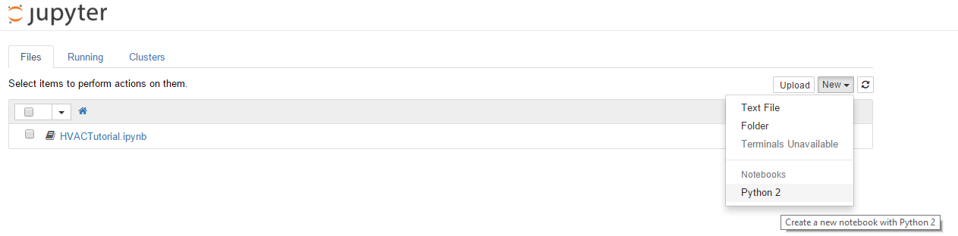
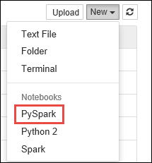
Notes:
Objective: This continues the Jupyter notebook demo.
Instructions:
You can create a new notebook of a text file or Python-supported notebook. In this UI, you can also see the running Jupyter processes, notebooks, and so on, as well as the status and progress of the IPython parallel computing clusters.

Slide 49
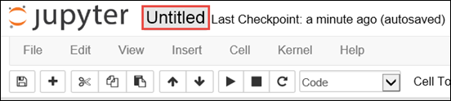
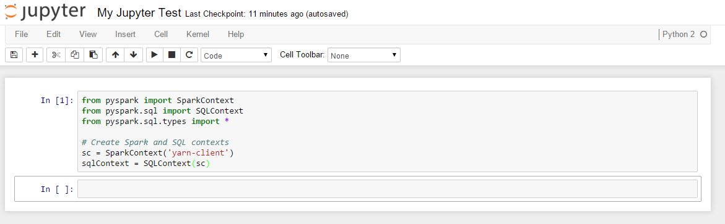
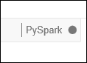
Notes:
Objective: This continues the Jupyter notebook demo.
Instructions:
Whenever a new notebook is created, it opens with the name Untitled.pynb. You can change the title by entering the appropriate name at the top of the page, in place of Untitled.
<<animation with click>> As shown in the code, first you need to import the required modules and create the SparkContext and SQLContext for the Jupyter notebook. To execute this code, press SHIFT + ENTER.
Every time you run a job in Jupyter, your web browser window title will show a (Busy) status along with the notebook title. You will also see a solid circle next to the Python 2 text in the top-right corner. After the job completes, this will change to a hollow circle.

Slide 50
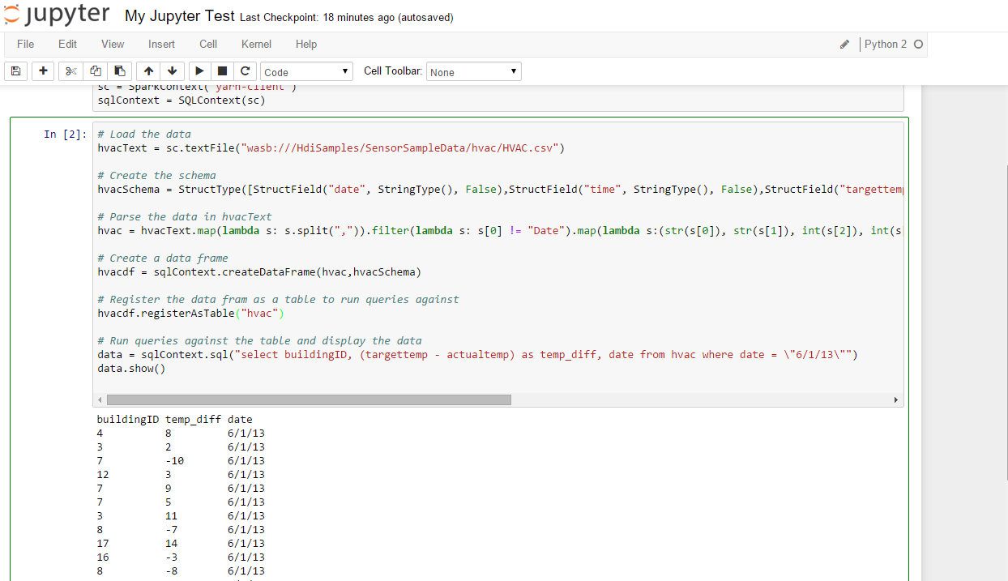
Notes:
Objective: This continues the Jupyter notebook demo.
Instructions:
Now we will load sample data of one of our sample files (hvac.csv) into a temporary table. When you create a Spark cluster in HDInsight, the sample data file, hvac.csv, is copied to the associated storage account under \HdiSamples\HdiSamples\SensorSampleData\hvac.
This code example registers the data into a temporary table with the name hvac.

Slide 51
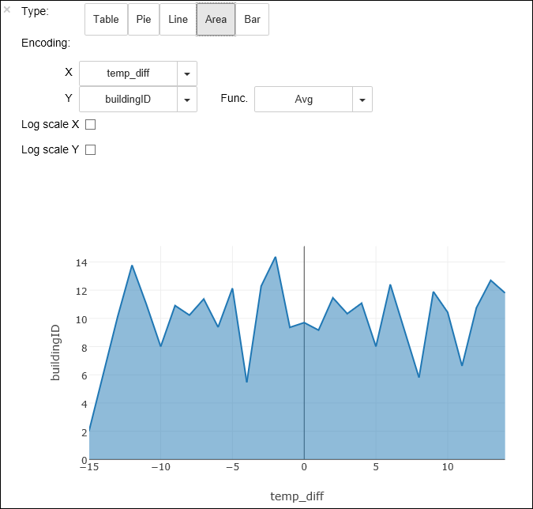
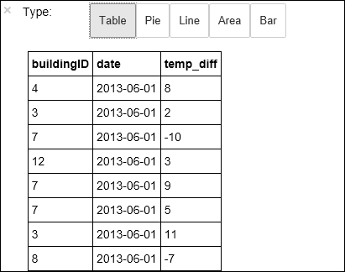
%%sql
SELECT buildingID, (targettemp - actualtemp) AS temp_diff, date FROM hvac WHERE date = \"6/1/13\"
Notes:
Objective: This continues the Jupyter notebook demo.
Instructions:
Because you are using a PySpark kernel, you can now directly run a SQL query on the temporary table hvac that you just created by using the %%sql magic. For more information about the %%sql magic, as well as other magics available with the PySpark kernel, see Kernels available on Jupyter notebooks with Spark HDInsight clusters. <<animation on click>>
Once the job is completed successfully, the following tabular output is displayed by default. <<animation on click>>
You can also see the results in other visualizations as well. For example, an area graph for the same output would look like the following. <<animation on click>>

Slide 52
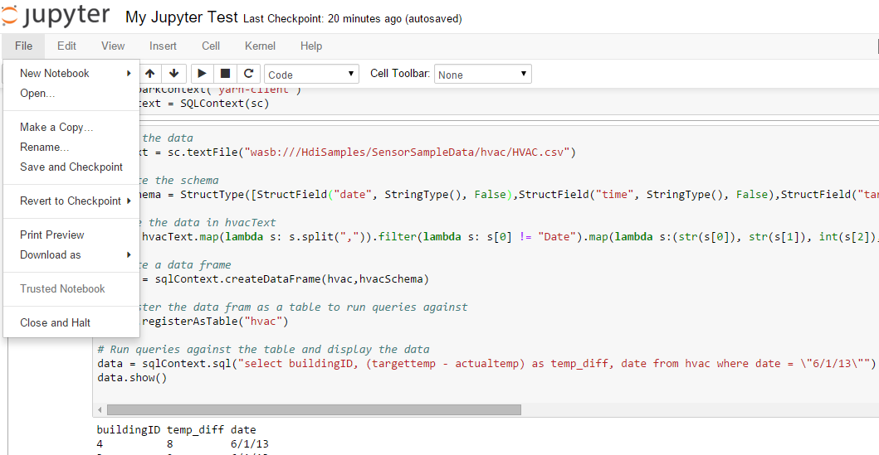
Notes:
Objective: This concludes the Jupyter notebook demo.
Instructions:
You need to make sure that after you have finished running the application, you shut down the notebook to release the resources. To do so, click Close and Halt from the file menu. This will shut down and close the notebook.

Slide 53
© 2016 Microsoft Corporation. All rights reserved. Microsoft, Windows, Windows Vista and other product names are or may be registered trademarks and/or trademarks in the U.S. and/or other countries.
The information herein is for informational purposes only and represents the current view of Microsoft Corporation as of the date of this presentation. Because Microsoft must respond to changing market conditions, it should not be interpreted to be a commitment on the part of Microsoft, and Microsoft cannot guarantee the accuracy of any information provided after the date of this presentation. MICROSOFT MAKES NO WARRANTIES, EXPRESS, IMPLIED OR STATUTORY, AS TO THE INFORMATION IN THIS PRESENTATION.

Slide 54
Spark SQL
Speaker name

Slide 55
Learning objectives
Spark SQL overview
DataFrames
Tables and queries

Slide 56
Overview

Slide 57
Spark SQL overview
Create an Azure storage account
HDInsight makes Apache Spark available as a service in cloud.
Run Spark SQL statements using notebooks
1
2
3
HDInsight uses Azure Blob storage account for storing data.
HDInsight makes Apache Spark available as a service in cloud.
You run interactive Spark SQL statements using notebooks.
Notes:
Objective: This slide explains the what and how of Spark SQL.
Talking points:
Functions as an extension to Spark for processing structured data
Part of the core distribution since Spark 1.0 (April 2014)
It is a distributed SQL query engine
It is also a general purpose distributed data processing API

Slide 58
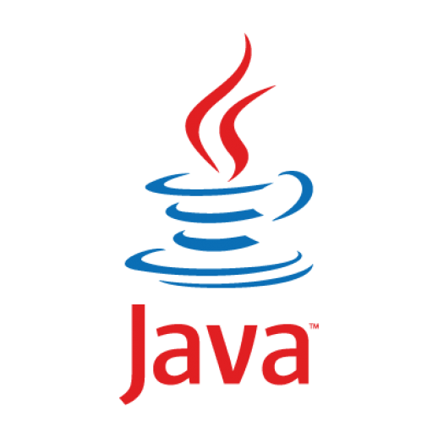
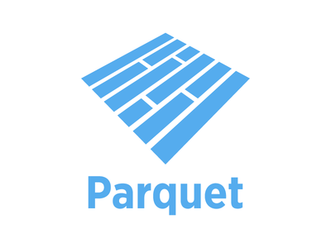

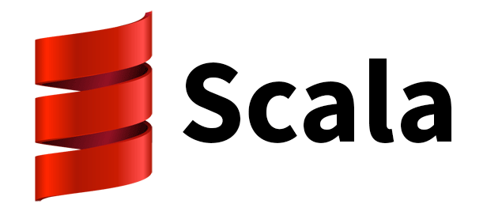



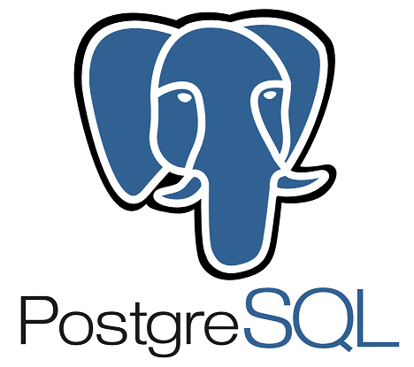
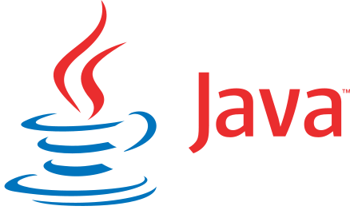



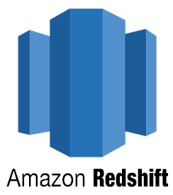






Spark SQL overview
Built-in
External
JDBC
And more…
Notes:
Objective: This slide explains the what and how of Spark SQL.
Talking points:
Supports SQL and HiveQL as query languages
Its capabilities include binding in Python, Scala, and Java
Can query data stored in external databases, structured data files (example: JSON), and Hive tables

Slide 59
SQLContext and HiveContext
The entry point into all functionality in Spark SQL is the SQLContext class, or one of its descendants. To create a basic SQLContext, all you need is a SparkContext.
>>> val sc: SparkContext // An existing SparkContext.
>>> val sqlContext = new org.apache.spark.sql.SQLContext(sc)
You can also create HiveContext instead of SQLContext. HiveContext is only packaged separately to avoid including all Hive dependencies in the default Spark build.
Notes:
Objective: This slide describes the different methods Spark SQL introduces and integrates new data.
Talking points:
SQLContext is the entry point into all functionality in Spark SQL, or one of its descendants. To create a basic SQLContext, all you need is a SparkContext.
Future releases will focus on bringing SQLContext up to feature parity with a HiveContext.
HiveContext
An instance of the Spark SQL execution engine that integrates with data stored in Hive. Configuration for Hive is read from hive-site.xml on the classpath. To use a HiveContext, you do not need to have an existing Hive setup, and all of the data sources available to a SQLContext are still available. HiveContext is packaged separately to avoid including all of Hive’s dependencies in the default Spark build. If these dependencies are not a problem for your application, then using HiveContext is recommended for the 1.3 release of Spark.
HiveContext also allows you to:
Write more using the more complete HiveQL parser
Gain access to Hive UDFs
Read data from Hive Tables
Use the spark.sql.dialect option to select the specific variant of the SQL used in the operation.
For SQLContext the only option is “sql”
For HiveContext the only option is “hiveql”

Slide 60
DataFrames

Slide 61
Core abstraction: DataFrames
A distributed collection of data organized into named columns.
Similar to RDDs with schema.
Conceptually equivalent to tables in relational database, or to DataFrames in R/Python.
With domain-specific functions designed for common tasks:
Metadata
Sampling
Project, filter, aggregation, and join
UDFs
RDDs are a collection of opaque objects (such as internal structures unknown to Spark).
User
User
User
User
User
User
DataFrames is a collection of objects with schema that are known to Spark SQL..
Name
Age
Sex
Name
Age
Sex
Name
Age
Sex
Name
Age
Sex
Notes:
Objective: This slide explains the architecture of DataFrames in Spark SQL and how the architecture processes the data.
Talking points:
A DataFrame is a distributed collection of data organized into named columns. It is conceptually equivalent to a table in a relational database or a data frame in R/Python, but with richer optimizations under the hood. DataFrames can be constructed from a wide array of sources such as: structured data files, tables in Hive, external databases, or existing RDDs.
The DataFrame API is available in Scala, Java, and Python.
Once built, DataFrames provide a domain-specific language for distributed data manipulation.
You can also incorporate Spark SQL while working with DataFrames.
Data scientists are employing increasingly sophisticated techniques that go beyond joins and aggregations. To support this, DataFrames can be used directly in the MLlib machine learning pipeline API. In addition, programs can run arbitrarily complex user functions on DataFrames.

Slide 62
Creating DataFrames from data sources
A Spark data source can read in-data to create DataFrames, which has a schema that Spark understands. Examples include: JSON files, JDBC source, Parquet, and Hive tables.
>>> val df = sqlContext.jsonFile(”somejasonfile.json“) //from JSON file*
>>> val df = hiveContext.table(”somehivetable“) //from a Hive Table
>>> val df = sqlContext.parquetFile(”someparquetsource“) //from a parquet file
>>> val df = sqlContext.load(source="jdbc", url=“UrlToConnect", dbtable=“tablename")//from JDBC source
* Note that the file that is offered as jsonFile is not a typical JSON file. Each line must contain a separate, self-contained valid JSON object. A regular multi-line JSON file will most often fail.
Notes:
Objective: This slide describes the different ways a DataFrame can be created through a data source.
Talking points:
Spark SQL supports operating on a variety of data sources through the DataFrame interface. A DataFrame can be operated on as a normal RDD and or registered as a temporary table. Registering a DataFrame as a table allows you to run SQL queries over its data. This section describes the general methods for loading and saving data using the Spark data sources and then goes into specific options that are available for the built-in data sources.
JSON file
You can also manually specify the data source that will be used along with any extra options that you would like to pass to the data source. Data sources are specified by their fully qualified name (for example, org.apache.spark.sql.parquet), but for built-in sources you can also use the shortened name (JSON, Parquet, JDBC). DataFrames of any type can be converted into other types using this syntax.
Spark SQL can automatically infer the schema of a JSON dataset and load it as a DataFrame. This conversion can be done using one of two methods in a SQLContext:
jsonFile – Loads data from a directory of JSON files, where each line of the files is a JSON object.
jsonRDD – Loads data from an existing RDD, where each element of the RDD is a string containing a JSON object.
Note that the file that is offered as jsonFile is not a typical JSON file. Each line must contain a separate, self-contained valid JSON object. As a consequence, a regular multi-line JSON file will most often fail.
Hive table
Spark SQL also supports reading and writing data stored in Apache Hive. However, since Hive has a large number of dependencies, it is not included in the default Spark assembly. Hive support is enabled by adding the -Phive and -Phive-thriftserver flags to the Spark build. This command builds a new assembly jar that includes Hive. Note that this Hive assembly jar must also be present on all of the worker nodes, as they will need access to the Hive serialization and deserialization libraries (SerDes) in order to access data stored in Hive.
Configuration of Hive is done by placing your hive-site.xml file in conf/.
Parquet file
In the simplest form, the default data source (parquet unless otherwise configured by spark.sql.sources.default) will be used for all operations.
Java Database Connectivity (JDBC) source
Spark SQL also includes a data source that can read data from other databases using JDBC. This functionality should be preferred over using JdbcRDD. This is because the results are returned as a DataFrame and can be easily processed in Spark SQL or joined with other data sources. The JDBC data source is also easier to use from Java or Python as it does not require the user to provide a ClassTag. (Note that this is different than the Spark SQL JDBC server, which allows other applications to run queries using Spark SQL.)

Slide 63
Creating DataFrames from RDDs
Create DataFrames from existing RDDs in two ways:
Use reflection: Infer the schema of an RDD that contains specific types of objects. This approach leads to more concise code. It works well when you already know the schema while writing your Spark application.
Specify the schema programmatically: Enables you to construct a schema then apply it to an existing RDD. This method is more verbose, but it enables you to construct DataFrames when the columns and their types are not known until runtime.
Create DataFrames from existing a JSON RDD, using the jsonRDD function.
>>> val df = sqlContext.jsonRDD(anUserRDD)
Notes:
Objective: This slide describe the different ways a DataFrame can be created through an RDD.
Talking points:
Using reflection:
The Scala interface for Spark SQL supports automatically converting an RDD containing case classes to a DataFrame. The case class defines the schema of the table. The names of the arguments to the case class are read using reflection and become the names of the columns. Case classes can also be nested or contain complex types such as sequences or arrays. This RDD can be implicitly converted to a DataFrame and then registered as a table. Tables can be used in subsequent SQL statements.
Specifying the schema programmatically:
When case classes cannot be defined ahead of time (for example, the structure of records is encoded in a string, or a text dataset will be parsed and fields projected differently for distinct users), a DataFrame can be created programmatically with three steps:
Create an RDD of rows from the original RDD
Create the schema represented by a StructType matching the structure of rows in the RDD created in Step 1
Apply the schema to the RDD of rows via the createDataFrame method provided by SQLContext.

Slide 64
DataFrame operations
DataFrames provide a domain-specific language for structured data manipulation in Scala, Java, and Python.
>>> val df = sqlContext.jsonFile(”somejasonfile.json“)
>>> df.show() // Show the contents of the DataFrame
>>> df.printSchema() // Print the schema in a tree format
>>> df.select(“name”).show() // Select and show the name columns
>>> df.select(df(”name”),df (“age”) +1).show() // Select all but increment the age by 1
>>> df.filter(df(”age”) > 21).show() // Select people older than 21
>>> df.groupBy(“age”).count().show() // Count people by age
Notes:
Objective: This slide describes the various DataFrame operations in Scala, Java, and Python.
Talking points:
Through certain DataFrame operations, you can use SQLContext to understand the construction and demographics of your data.
df.show() – This operation shows the contents of the data you have selected
df.printSchema() – This operation prints your schema (table) in a tree format
df.select(“name”).show() – This operation will select and display the name you have selected for the columns you’ve specified
df.select(dr(“name”),df(“age”) + 1).show() – This operation example will select all your data as well as add one to each of the ages shown
df.filter(df(“age”) > a21.show() – This operation example will select all data that shows that the data is greater than 21
Df.groupBy(“age”).count().show() – This operation example will count the data you’ve selected by age and show you only the results that meet the criteria you’ve presented

Slide 65
Tables and queries

Slide 66


Tables and queries
A DataFrame can be registered as a table that can then be used in SQL queries.
// First create a DataFrame from JSON file.
>>> val df = sqlContext.jsonFile(”Users.json“)
// Register the DataFrame as a temporary table. Temp tables exist only during lifetime of this SQLContext instance.
>>> val usertable = sqlContext.registerDataFrameAsTable(df, “UserTable”)
// Alternatively, execute a SQL query on the table. The query returns a DataFrame.
>>> val teenagers = sqlContext.sql(“select Age as Years from UserTable where age > 13 and age <= 19”)
JSON file
DataFrame
Register DataFrame as table
SQL query
DataFrame
Notes:
Objective: This slide frames the DataFrames that can be registered as a table to be used in SQL queries.
Talking points:
To analyze or query your data in SQL, you can use the following method to create and register your DataFrame from a JSON file into SQLContext to perform executable SQL queries.

Slide 67
Hive tables
Spark SQL also supports reading and writing data stored in Apache Hive.
// Create a HiveContext, which is derived from SQLContext. >>> val sqlContext = new org.apache.spark.sql.hive.HiveContext(sc)
>>> sqlContext.sql("CREATE TABLE IF NOT EXISTS UserTable (key INT, value STRING)")
>>> sqlContext.sql("LOAD DATA LOCAL INPATH ‘user.txt' INTO TABLE UserTable")
// Queries are expressed in HiveQL.
>>> val df = sqlContext.sql("FROM UserTable SELECT Name, Age")
Notes:
Objective: This slide shows how Spark SQL supports reading and writing data stored in another tool, Apache Hive.
Talking points:
Spark SQL supports reading and writing data stored in Apache Hive. However, since Hive has a large number of dependencies, it is not included in the default Spark assembly. Hive support is enabled by adding the -Phive and -Phive-thriftserver flags to the Spark build. This command builds a new assembly jar that includes Hive. Note that this Hive assembly jar must also be present on all of the worker nodes, as they will need access to the Hive serialization and deserialization libraries (SerDes) in order to access data stored in Hive.
Configuration of Hive is done by placing your hive-site.xml file in conf/
Saving to persistent tables:
When working with a HiveContext, it is possible to save a DataFrame persistently. Persistent tables continue to exist even after your Spark program has restarted. Just make sure to maintain your connection to the same metastore.
saveAsTable() saves the content of the DataFrame to a data source as a table. It then materializes the contents of the DataFrame and creates a pointer to the data in the HiveMetastore.
By default, saveAsTable creates a “managed table.” The megastore controls the location of the data, and automatically deletes data on the managed tables when a table is dropped.

Slide 68
Demo
Hive tables
Notes:
Sources:
https://channel9.msdn.com/Series/Azure-Data-Lake/Whats-up-with-Spark25-SparkSQL
Microsoft Azure – BI Tools: Save raw data as a Hive table
https://azure.microsoft.com/en-us/documentation/articles/hdinsight-apache-spark-use-bi-tools/
Microsoft Azure – BI Tools: Use Power BI to analyze data in the Hive table
https://azure.microsoft.com/en-us/documentation/articles/hdinsight-apache-spark-use-bi-tools/
Microsoft Azure - Machine learning: Predictive analysis on food inspection data using MLlib with Spark on HDInsight: Construct an input dataframe
https://azure.microsoft.com/en-us/documentation/articles/hdinsight-apache-spark-machine-learning-mllib-ipython/

Slide 69
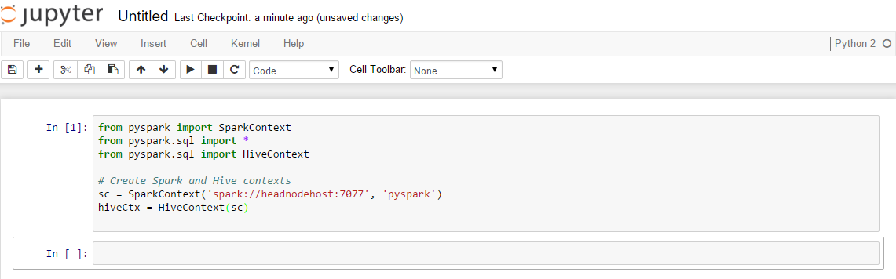
Notes:
Objective: This slide begins the Hive table demo.
Instructions:
In this section, we use the Jupyter notebook associated with an Apache Spark cluster in HDInsight to run jobs that process your raw sample data and save it as a Hive table. The sample data is a CSV file (hvac.csv) available on all clusters by default.
Once your data is saved as a Hive table, we will then connect to the Hive table using BI tools such as Microsoft Power BI and Tableau.
First, we need to import the required modules and create the SparkContext and HiveContext.
Every time you run a job in Jupyter, your web browser window title will show a (Busy) status along with the notebook title. You will also see a solid circle next to the Python 2 text in the top-right corner. After the job completes, this will change to a hollow circle.

Slide 70
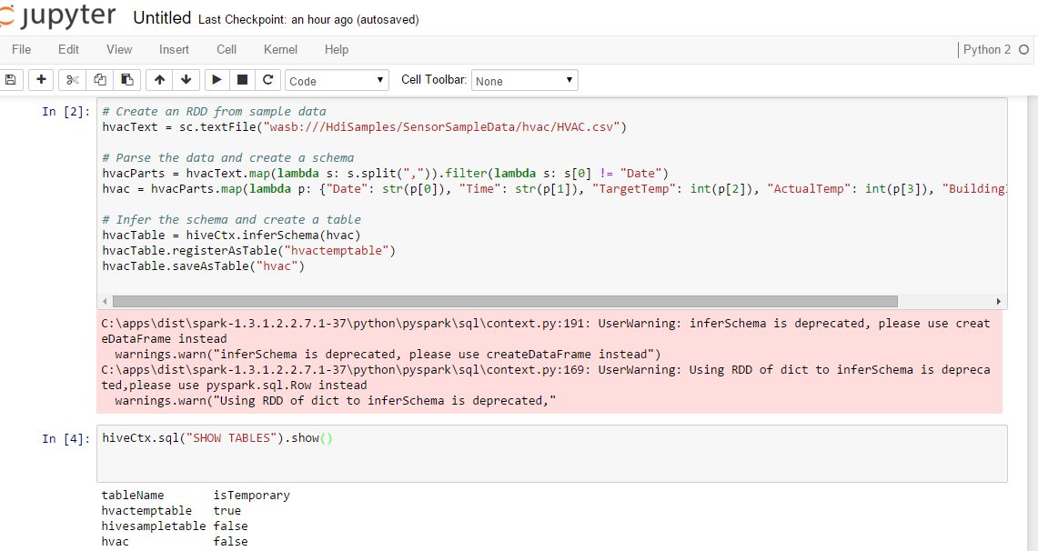
Notes:
Objective: This slide continues the Hive table demo.
Instructions:
Now we will load some sample data into a temporary table.
When you provision a Spark cluster in HDInsight, the sample data file, hvac.csv, is copied to the associated storage account under \HdiSamples\SensorSampleData\hvac. We will use this CSV and create a Hive Table.
If you look at the code, first we create an RDD from sample data. Then we create the required schema and parse the data.
Next, we register the data into a Hive table called HVAC. To verify that the table was successfully created, we provided the SQL command of Show table. Only the tables that have “false” under the isTemporary column are Hive tables that will be stored in the metastore and able to be accessed from the BI tools.

Slide 71
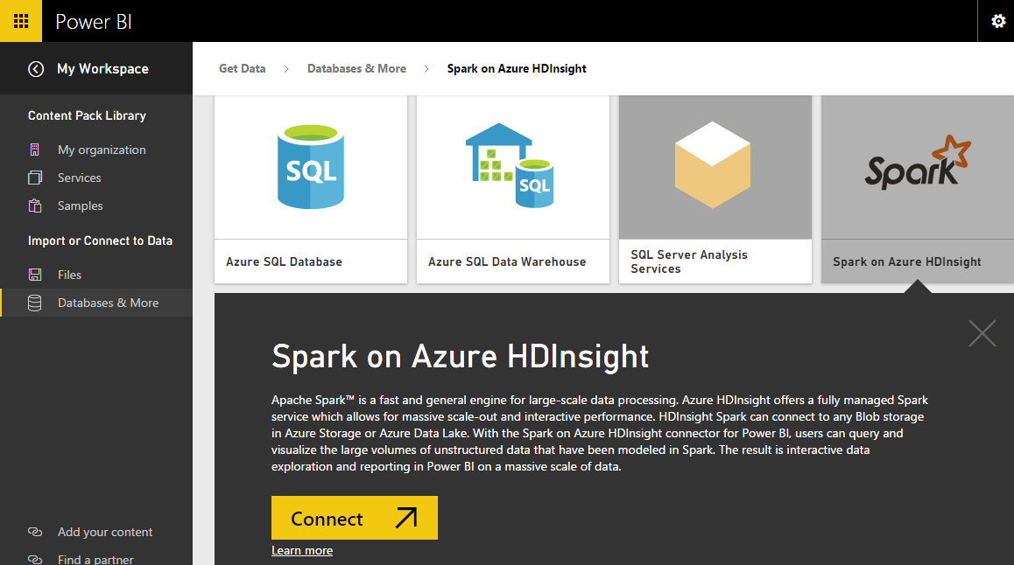
Notes:
Objective: This slide continues the Hive table demo.
Instructions:
Once you have saved the data as a Hive table, you can use Microsoft Power BI to connect to the data and visualize it to create reports, dashboards, and so on. Spark on Azure HDInsight with direct connect allows you to create dynamic reports based on data and metric you already have in your Spark cluster. With direct connect, queries are sent back to your Azure HDInsight Spark cluster as you explore the data in the report view. This experience is suggested for users who are familiar with the entities they connect to.

Slide 72
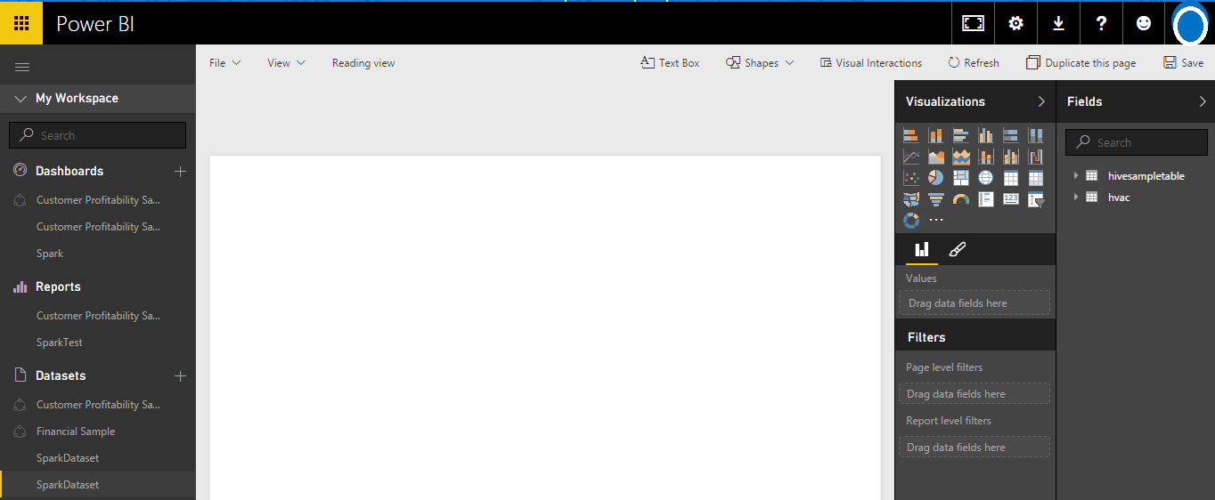
Notes:
Objective: This slide continues the Hive table demo.
Instructions:
After the connection is established, Microsoft Power BI starts importing data from the Spark cluster on HDInsight. Power BI imports the data and displays the new dashboard. A new data set is also added under the Datasets heading.

Slide 73
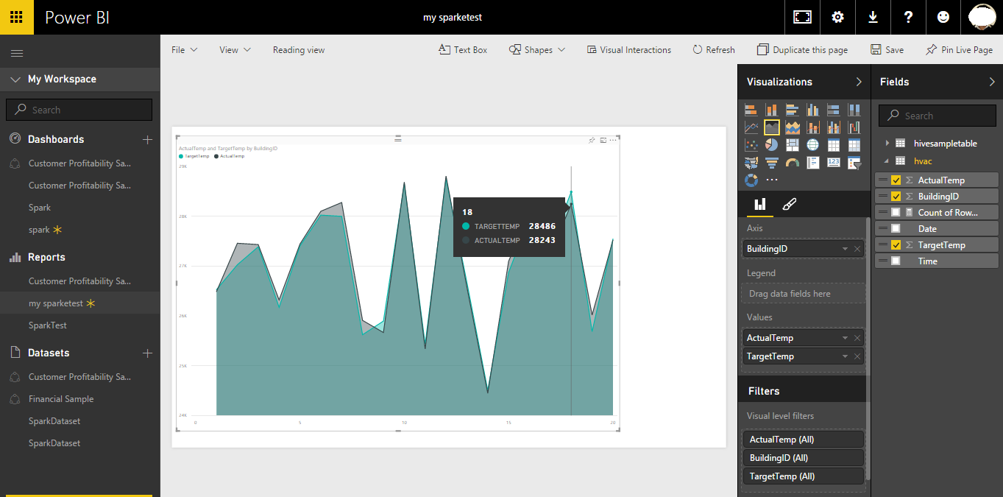
Notes:
Objective: This slide concludes the Hive table demo.
Instructions:
Build a visualization to show the variance between target temperature and actual temperature for each building. You just need to drag and drop the required fields into the respective axis and value. Move your cursor over the visualization to get tool tips with relevant data. You can also pin the visualization, storing it on your dashboard so you can track the latest value at a glance.
Also, Spark clusters on HDInsight are connected to Microsoft Power BI with direct connect. This means that Power BI always has the most up-to-date from your cluster so you do not need to schedule refreshes for the dataset.

Slide 74
© 2016 Microsoft Corporation. All rights reserved. Microsoft, Windows, Windows Vista and other product names are or may be registered trademarks and/or trademarks in the U.S. and/or other countries.
The information herein is for informational purposes only and represents the current view of Microsoft Corporation as of the date of this presentation. Because Microsoft must respond to changing market conditions, it should not be interpreted to be a commitment on the part of Microsoft, and Microsoft cannot guarantee the accuracy of any information provided after the date of this presentation. MICROSOFT MAKES NO WARRANTIES, EXPRESS, IMPLIED OR STATUTORY, AS TO THE INFORMATION IN THIS PRESENTATION.

Slide 75
Hands-on lab
Running interactive Spark SQL queries with Jupyter

Slide 76
© 2016 Microsoft Corporation. All rights reserved. Microsoft, Windows, Windows Vista and other product names are or may be registered trademarks and/or trademarks in the U.S. and/or other countries.
The information herein is for informational purposes only and represents the current view of Microsoft Corporation as of the date of this presentation. Because Microsoft must respond to changing market conditions, it should not be interpreted to be a commitment on the part of Microsoft, and Microsoft cannot guarantee the accuracy of any information provided after the date of this presentation. MICROSOFT MAKES NO WARRANTIES, EXPRESS, IMPLIED OR STATUTORY, AS TO THE INFORMATION IN THIS PRESENTATION.

Slide 77
Hands-on lab
Working with Hive and Power BI in Apache Spark

Slide 78
© 2016 Microsoft Corporation. All rights reserved. Microsoft, Windows, Windows Vista and other product names are or may be registered trademarks and/or trademarks in the U.S. and/or other countries.
The information herein is for informational purposes only and represents the current view of Microsoft Corporation as of the date of this presentation. Because Microsoft must respond to changing market conditions, it should not be interpreted to be a commitment on the part of Microsoft, and Microsoft cannot guarantee the accuracy of any information provided after the date of this presentation. MICROSOFT MAKES NO WARRANTIES, EXPRESS, IMPLIED OR STATUTORY, AS TO THE INFORMATION IN THIS PRESENTATION.

Slide 79
Big Data: Apache Spark wrap-up
Speaker name

Slide 80

Summary of Day 1
Apache Spark overview
Working with RDDs
Working with notebooks on Apache Spark
Spark SQL
Running interactive Spark SQL queries
Working with Hive & Power BI

Slide 81
Day 2 – Spark Streaming and machine learning
Day 2
Time | Title
8:00 - 8:15 | Welcome back
8:15 - 9:15 | Spark Streaming overview
9:15 - 10:00 | Spark Streaming with Event Hubs and Scala applications
10:00 - 10:15 | Break
10:15 - 11:00 | Machine learning with Spark MLlib
11:00 - 11:45 | Building applications with Spark MLlib
11:45 - 12:30 | Apache Spark in Azure HDInsight
12:30 – 12:45 | R Server on HDInsight with Apache Spark
12:45 - 1:00 | Day Two and final wrap-up

Slide 82
© 2016 Microsoft Corporation. All rights reserved. Microsoft, Windows, Windows Vista and other product names are or may be registered trademarks and/or trademarks in the U.S. and/or other countries.
The information herein is for informational purposes only and represents the current view of Microsoft Corporation as of the date of this presentation. Because Microsoft must respond to changing market conditions, it should not be interpreted to be a commitment on the part of Microsoft, and Microsoft cannot guarantee the accuracy of any information provided after the date of this presentation. MICROSOFT MAKES NO WARRANTIES, EXPRESS, IMPLIED OR STATUTORY, AS TO THE INFORMATION IN THIS PRESENTATION.

